Slide 1
Investigating the effect of Coronavirus Lockdowns on Crime Rates within the UK
ECS750P – MSc Data Science and AI
Elliot Linsey - 210764484

Slide 2
Agenda
Introduction and Background
Methods
Results and Demonstration
Conclusion

Slide 3

Introduction
Problem statement
Investigate the effect of the pandemic lockdowns on crime rates within the UK using classical and Bayesian statistical methods.
Did the lockdowns cause significant differences to crime rates during the pandemic?
Can the true crime rates be modelled with Bayesian methods by using the reported data and prior knowledge?

Slide 4
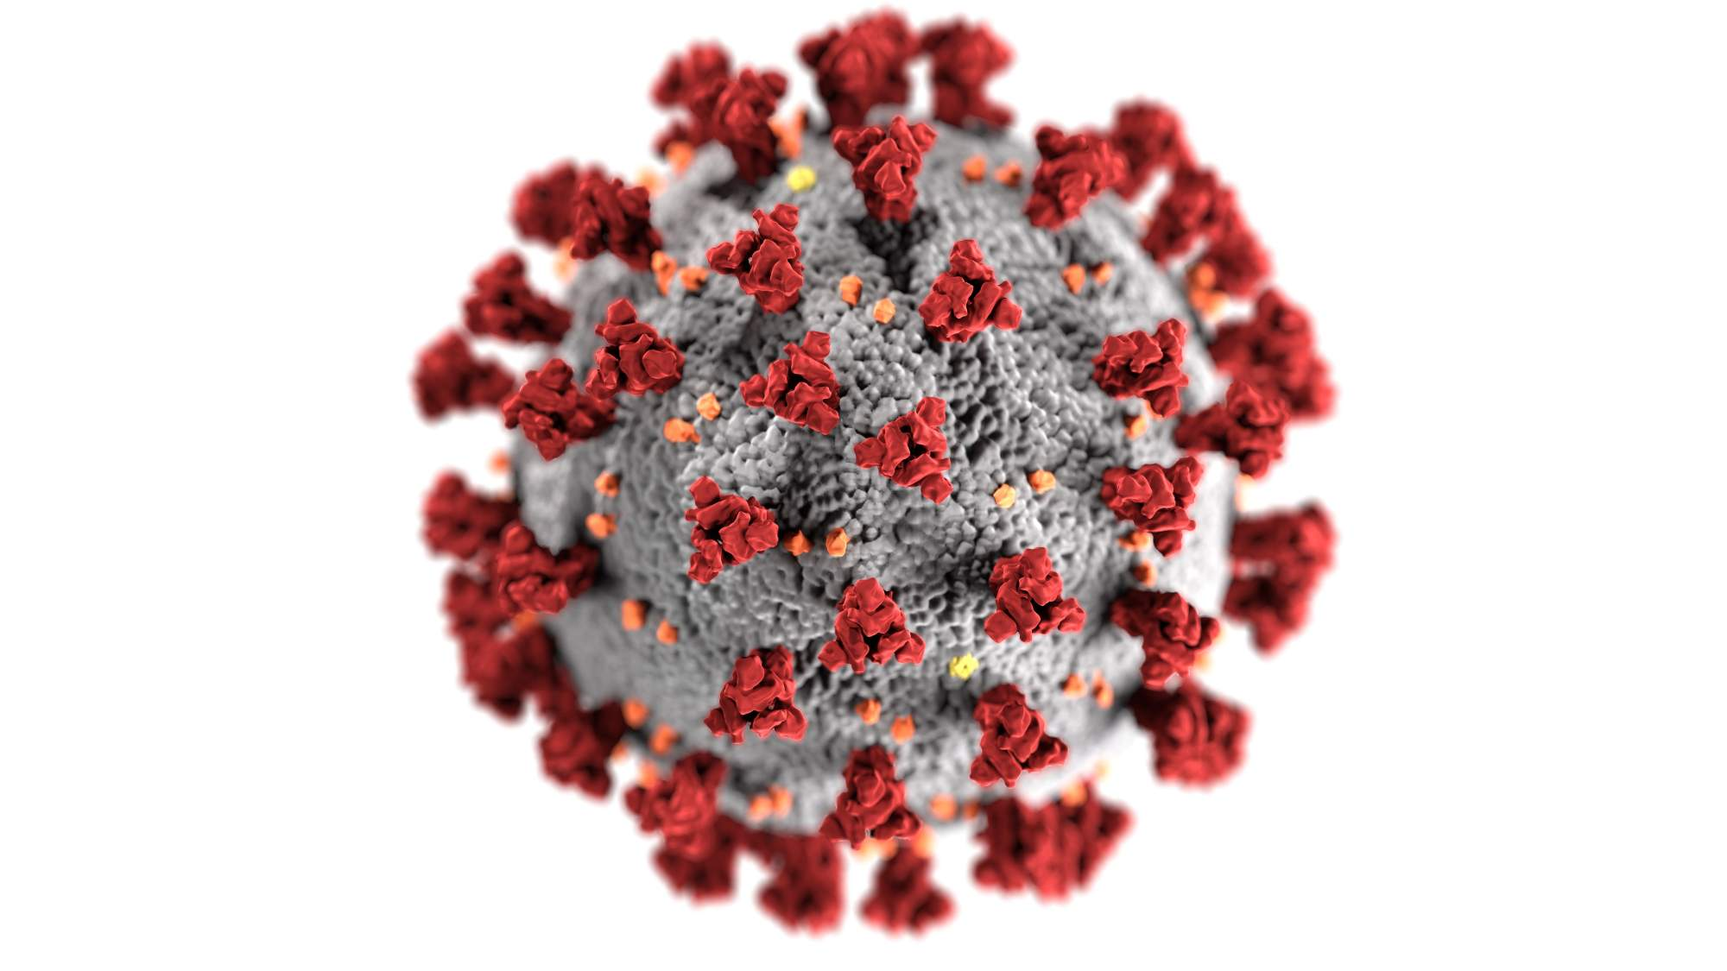
Background
In March 2020 to August 2021, approximately 90 countries introduced lockdown measures to slow the spread of the coronavirus pandemic
This was an unprecedented event on a global scale. All sectors were affected, including hospitality, construction, education, travel, and the judicial system (ONS, 2020)
These lockdowns included stay-at-home orders which reduced the mobility of the general public, this is theorised to affect crime rates (Farrell et al, 2020)
Some forms of crime, such as domestic violence and drug use, could be expected to rise due to these restrictions. Others, such as theft and alcohol-fueled fights, could be expected to decrease.
Most research into this topic only looked at the first 6 months. Only recently has data of the entire time period been made available
Notes:
The coronavirus virus originated in Asia and spread across the globe and to the UK in March 2020.
This event resulted in lockdown orders being placed within the UK. Due to the lockdowns restricting mobility, it is theorised that certain crime types may decrease due to less potential victims and perpetrators being present in public

Slide 5

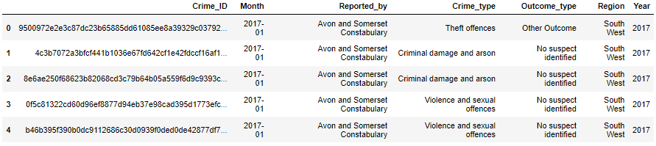
Data
The data was openly sourced from https://data.police.uk/. This provided data on each crime reported to the police throughout the UK from 2017 – 2021.
5 crime types were investigated: Violence and sexual offences, theft offences, criminal damage and arson, public order offences, drug offences.
4 outcome types were also investigated: No suspect identified, unable to prosecute suspect, suspect charged, other outcome.
40 police forces were amalgamated into 5 distinct regions: North, East Midlands, West Midlands, South East, South West.
Table 1 - A slice of the data
Notes:
Theft was made up of multiple subtypes such as burglary and bicycle theft
Other outcome was made from subtypes such as caution, fine, suspect jailed
Greater Manchester, British transport police and northern Ireland were removed

Slide 6
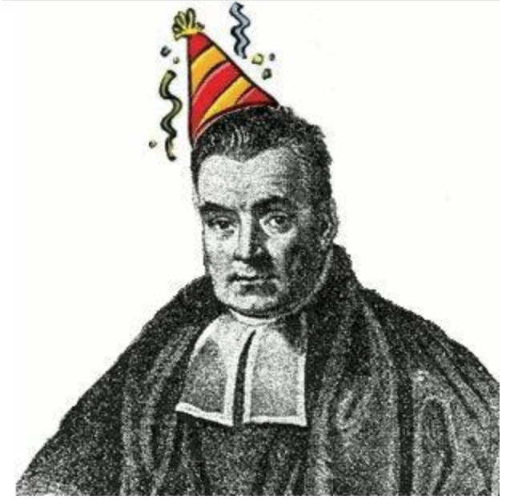
Method
Thomas Bayes, 1701 - 1761
Both classical and Bayesian methods were used
Seasonal ARIMA (Auto Regressive Integrated Moving Average) model was used with data from 2017 and 2019 to predict what the crime rates of 2020 and 2021 may have looked like without the pandemic interference
Regional differences for both crime rates and outcome rates were investigated using percentage changes and probabilities to account for different population sizes
A chi-squared test was performed to test the independence of the two features ‘year’ and ‘crime type’
2 Bayesian networks were created, one that further investigated the relationships between the chosen variables and another that estimated the true monthly crime rates from the reported crime rates
Notes:
95% conf intervals for ARIMA
Chi squared was attempting to see if there was a relationship between the two variables.

Slide 7
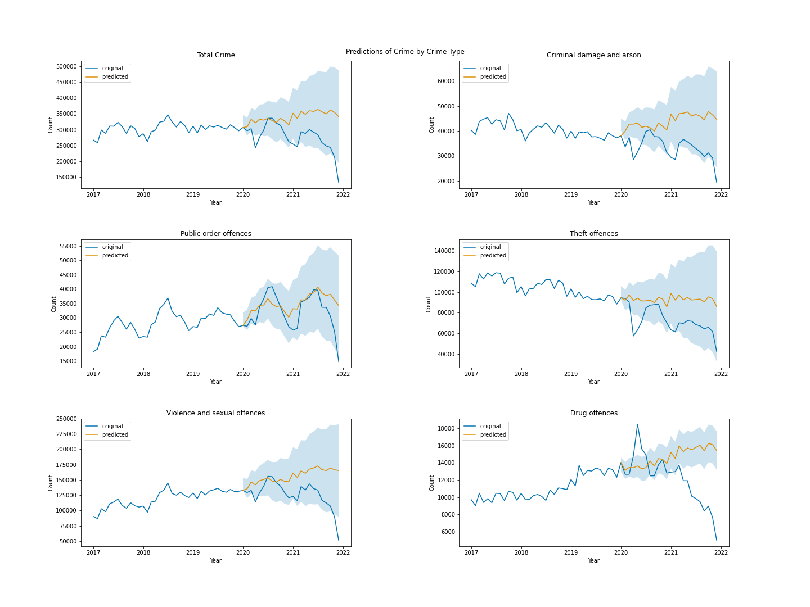
ARIMA
Significant drops experienced in ‘Total Crime’, ‘Criminal Damage and Arson’, ‘Theft offences’. Small drop experienced in ‘Violence and Sexual Offences’.
Large spike in ‘Drug Offences’. No major change in ‘Public Order Offences’.
Drops seen at the end of 2021 are due to reporting lag. Not all the data has been put into the system at this point.
Figure 1 – ARIMA Predictions
Notes:
The further along, the less confident the predictions are.

Slide 8
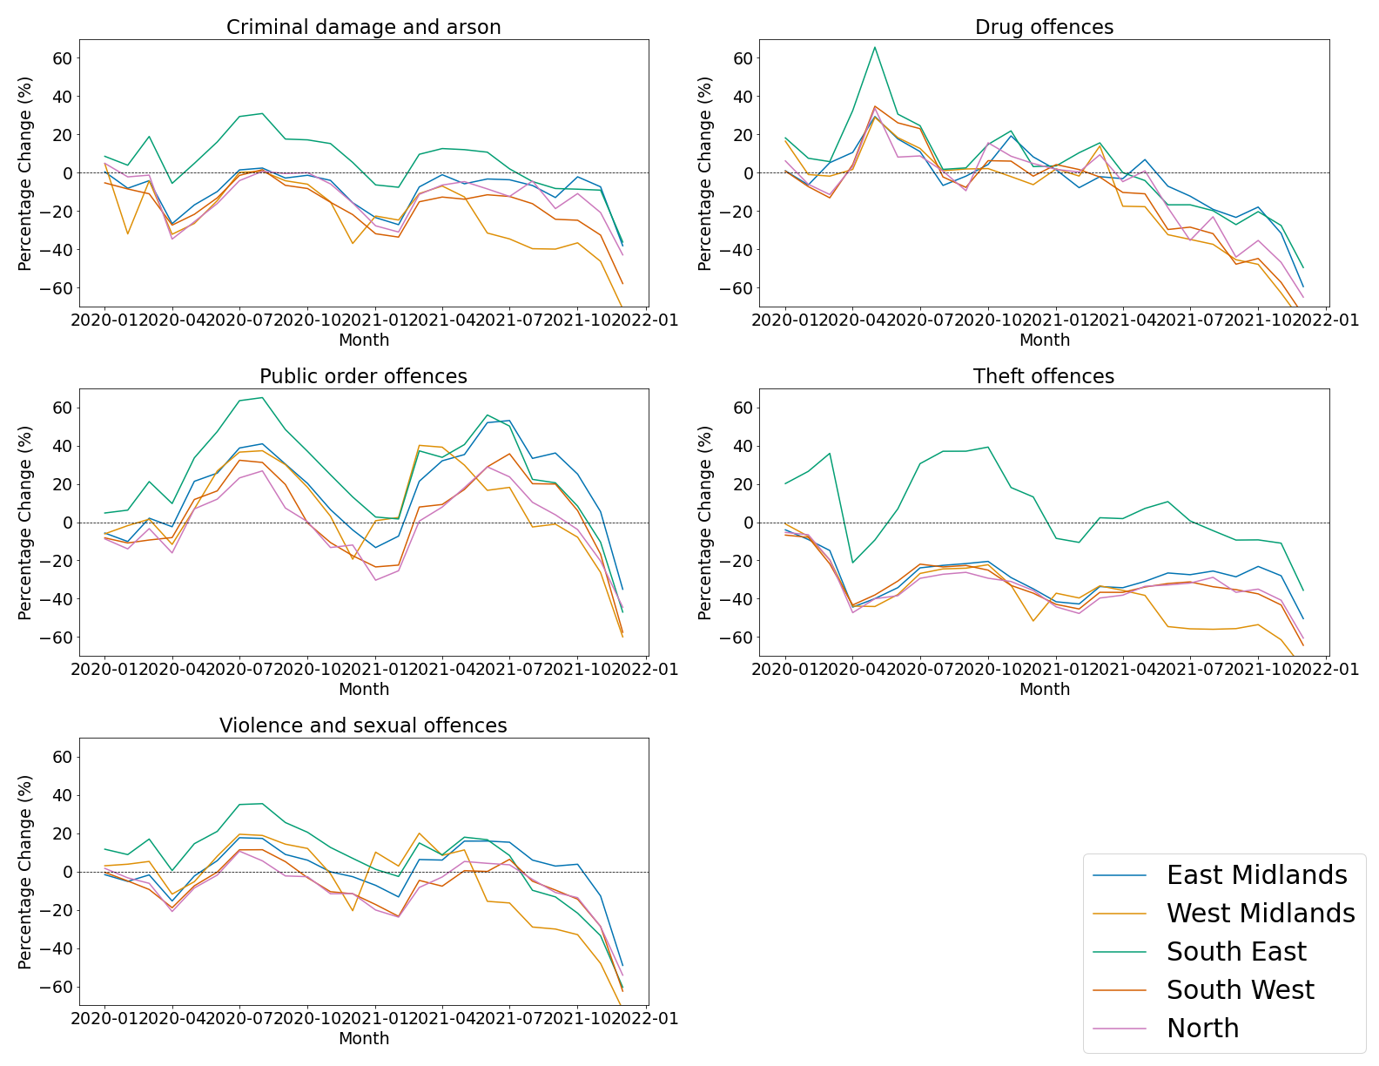
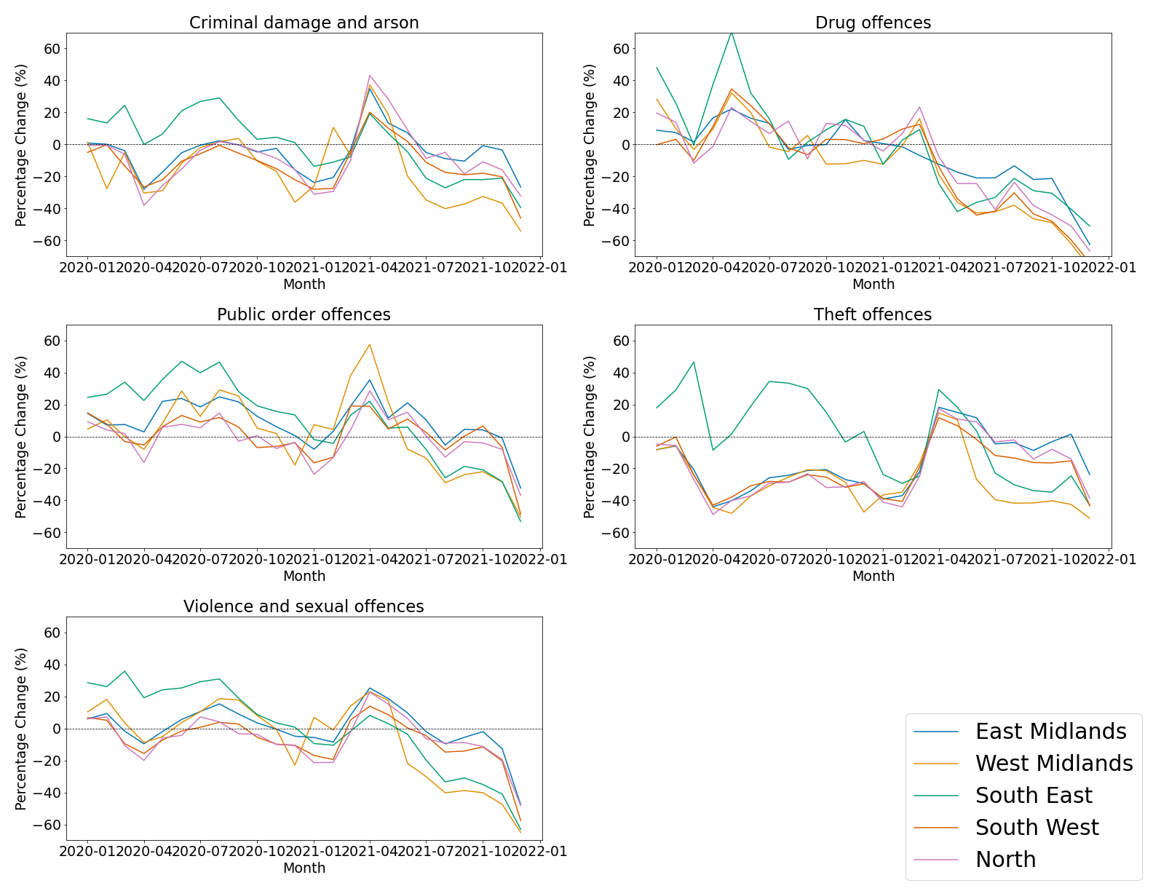
Percentage Changes
Percentage Change to 2019 by Region
Percentage Change to Previous Year by Region
Figure 2 - Percentage Change to 2019 by Region
Figure 3 - Percentage Change to Previous Year by Region

Slide 9
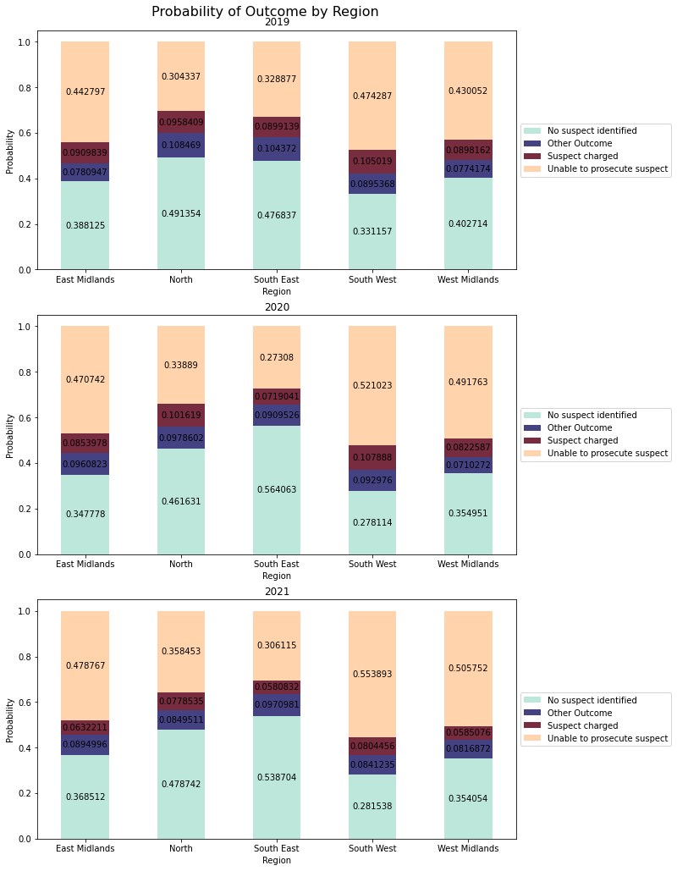
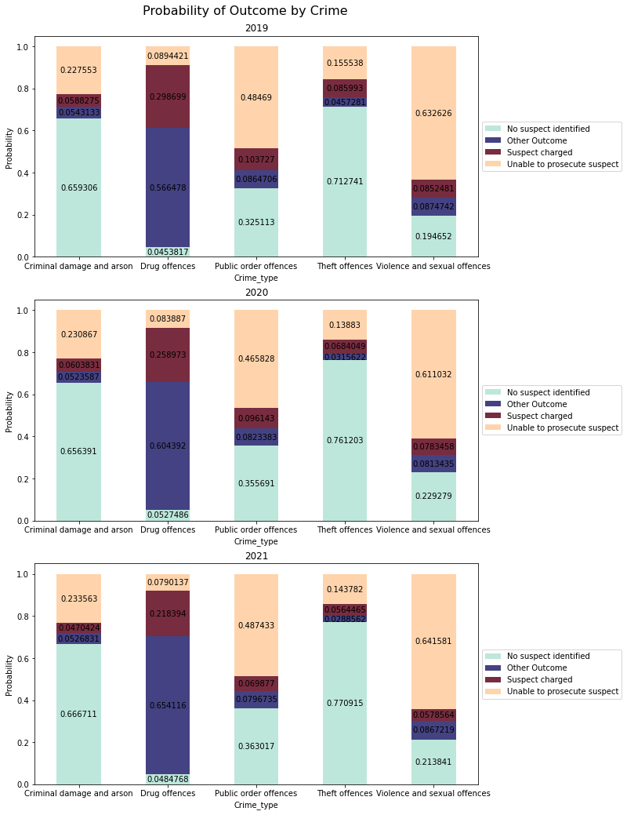
Probabilities
Figure 4 – Probability of outcome by Region
Figure 5 – Probability of outcome by crime type
Notes:
Greatest change was around 9% for both no suspect identified with south east and other outcome for drug offences

Slide 10
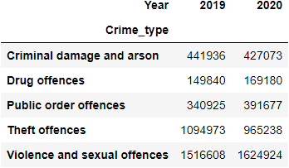
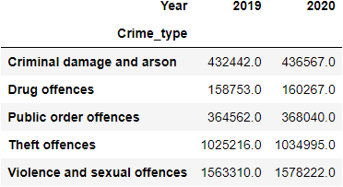
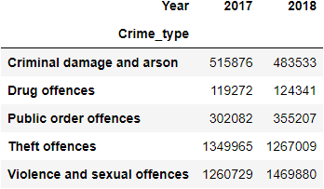
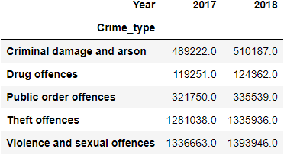
Chi-Squared Test
Table 2 - Actual Covid Crime Rates
Table 3 - Expected Covid Crime Rates
Resulting p-value for both tests was < 0.00001
Indicates that both year and crime type are not independent, however this is of little to no practical use due to the large sample size
The fact that both 2017 and 2018 also have an extremely low p-value and are non-covid years emphasises this
Table 4 - Actual Non-Covid Crime Rates
Table 5 - Expected Non-Covid Crime Rates

Slide 11
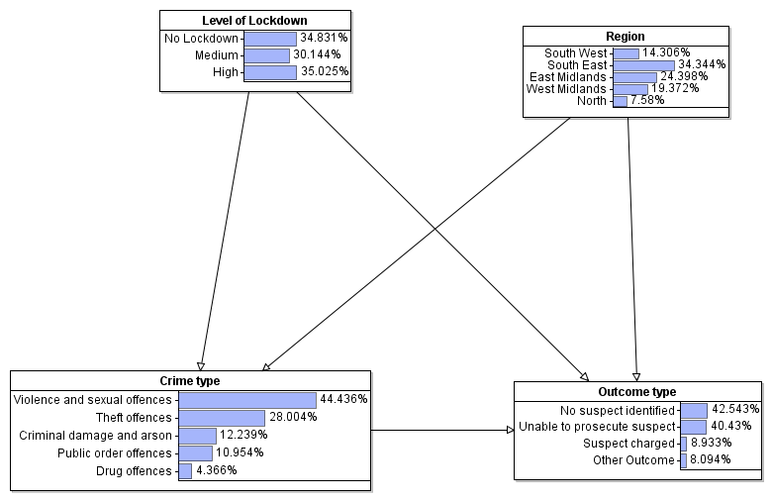
Bayesian Networks
Web Accessible at https://crimeduringcovid.staging.agenarisk.app/
Figure 6 – Bayesian Network investigating relationships between variables

Slide 12
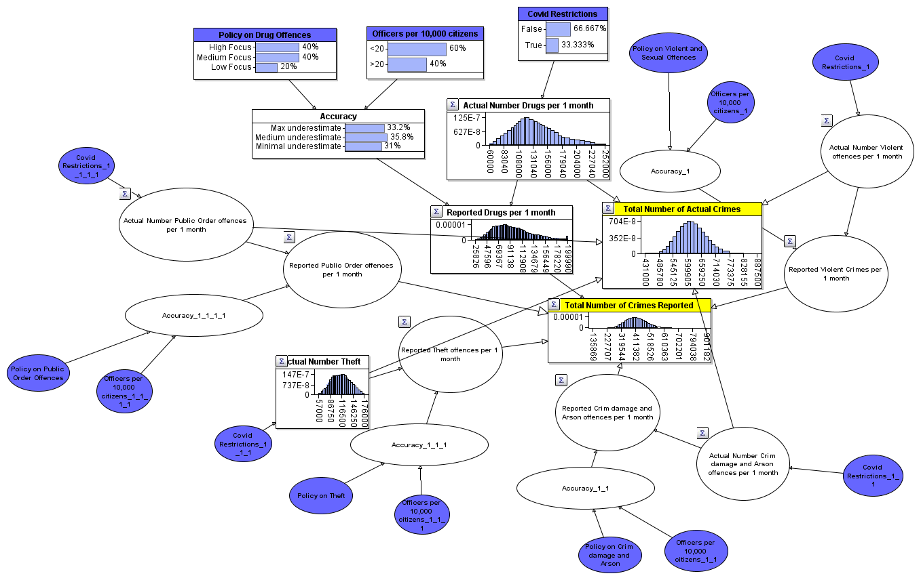
Bayesian Networks
Web Accessible at https://actualvsreportedcovidcrimes.staging.agenarisk.app/
Figure 7 – Bayesian Network Estimating True Crime Rates

Slide 13
Bayesian Networks
Both models are web accessible at: https://crimeduringcovid.staging.agenarisk.app/ and https://actualvsreportedcovidcrimes.staging.agenarisk.app/
Please email elliot.linsey@gmail.com for access
 | Lockdown |  | Non-Lockdown
Crime Type | Actual | Reported | Actual | Reported
Drugs | 168,000 | 117,000 | 120,000 | 83,000
Violence | 264,000 | 190,000 | 220,000 | 158,000
Criminal Damage | 72,000 | 47,000 | 82,000 | 54,000
Theft | 95,000 | 59,000 | 126,000 | 79,000
Public Order | 65,000 | 43,000 | 52,000 | 34,000
Total | 664,000 | 456,000 | 600,000 | 408,000
Table 6 – Results of Figure 7

Slide 14
Conclusion
Total crime was significantly affected by coronavirus, including both reported and actual
Some types of crime increased whilst others decreased
There are great differences for outcomes between regions, crime types and their outcomes, but coronavirus did not seem to have a large effect with the greatest difference being approximately 9%
Crime levels started to recover to pre-pandemic levels and patterns fairly quickly

Slide 15
References
Farrell, G., N. Tilley. (2020). Coronavirus: How crime changes during a lockdown. The Conversation, 02 April. Coronavirus: how crime changes during a lockdown (theconversation.com) accessed [09/08/22]
Office for National Statistics (ONS), (2020). The impact of the coronavirus so far: the industries that struggled or recovered. Link: https://www.ons.gov.uk/economy/economicoutputandproductivity/output/articles/theimpactofthecoronavirussofartheindustriesthatstruggledorrecovered/2020-12-09 accessed [09/08/22]

